Slide 2
Please note, information is updated rapidly as CARES Act passage authorizes SBA to create new programs. This information is current as of 4/22/20. Please check SBA.gov/coronavirus for the most up-to-date information.

Slide 3
At this time, by law, the SBA will not be able to issue new loan approvals for either of our disaster lending programs. Due to limited funding, the application portal for the EIDL–COVID-19 assistance program is temporarily closed. We are also not accepting additional Paycheck Protection Program applications from participating lenders at this time until additional funding is authorized.

Slide 4
Financial Assistance Available
For small business affected by COVID-19 (as of 3/31/20)
Debt Deferment or Relief:
Automatically deferring payments on existing disaster loans thru 12/31/20
Existing 7(a), 504 and microloans can be deferred – talk to your lender
SBA Debt Relief Program
The SBA will also pay the principal and interest of new 7(a) loans, 504 loans, and microloans issued prior to September 27, 2020.
The SBA will pay the principal and interest of current 7(a) loans, 504 loans, and microloans for a period of six months.
Paycheck Protection Program – Available now, availability is expanding daily
Economic Injury Disaster Loan
EIDL Advance of up to $10,000. The advance does not need to be repaid.

Slide 5
Additional Support
Small Business Development Center network has received additional funding to support business owners with recovery, applications, and assistance. ASKSBDC.com, 1-833-ASK-SBDC or loans@asksbdc.org
Women’s Business Center has received additional funding for Coronavirus response and recovery
State of California Programs to support business owners are launching and being updated frequently – business.ca.gov/coronavirus
Keep an eye on your local jurisdictions and foundations

Slide 6
Economic Injury Disaster Loan (EIDL)
What is it?
Low-interest loan for working capital to small business suffering economic injury as a result of COVID-19
Max loan size $2 million
Pay for financial obligations and operating expenses which could have paid had the disaster not occurred
Includes: Fixed expenses, rent, payroll, accounts payable, extraordinary expenses incurred due to disaster
Does not include: refinancing long-term debt
Disaster loan provided directly by SBA
This is not a 7(a) loan
Does not have same criteria as 7(a)
Up to 10,000 advance as a result of the CARES act

Slide 7
Economic Injury Loan Program
Updates
Funding is currently paused and applications are not being accepted
Applications are being processed on a first come first serve basis.
To ensure that the greatest number of applicants can receive assistance, the office of disaster assistance calculates the amount of an Advance by the number of your pre-disaster (i.e., as of January 31, 2020) employees. The Advance will provide $1,000 per employee up to a maximum of $10,000.
The SBA disaster office is the only source for updates on submitted applications 1-800-659-2955
Report released on # of applications funded so far. 6,820 applications, $1.4B in California. 114K Advances and $484M in California
Phase 2 funding is significantly higher

Slide 8
Paycheck Protection Program
Loan provided by participating lenders to pay up to 8 weeks of payroll costs, including benefits. Funds may pay interest on mortgage, rent and utilities
Payroll costs include:
Salary/wages/commissions/tips (cap: $100,000 annualized/employee)
Employee benefits such as vacation/sick leave, health care benefits, insurance premiums and retirement benefits
State and local taxes assessed on compensation
Purpose is to keep employees on the payroll or rehire quickly
Loan will be forgiven if used for payroll expenses – not more than 25% of costs may be for mortgage interest, rent/utilities.
Available: retroactive from Feb. 15, 2020, so employers can rehire their recently laid-off employees through June 30, 2020.

Slide 9
PPP Details
Eligible businesses: All small businesses, including non-profits, Veterans organizations, Tribal concerns, sole proprietorships, self-employed individuals, and independent contractors
Maximum loan: $10 million
Interest Rate: 1% (subject to change)
Term: 2 years
Payment deferral for 6 months
100% guarantee by SBA
No collateral
No personal guarantee
No borrower or lender fees payable to SBA
Find a PPP lender: https://www.sba.gov/paycheckprotection/find

Slide 10
Paycheck Protection Program
Updates
Availability from lenders – over 5,000 lenders in the system now. Online lenders are now involved (square, paypal, quicken, etc.)
Funding timelines
Sole proprietors, 1099, self-employed can apply(wages, commissions, income, or net earnings from self-employment)
How to calculate payroll
Where guidance is released: home.treasury.gov/cares
Overall Program availability – phase 2 coming.
Initial report released. For California 112K applications and $33B, 74% under $150K
Detailed information about applying for forgiveness is forthcoming, but has not been released. Business owners will need to rely on their lender.

Slide 11
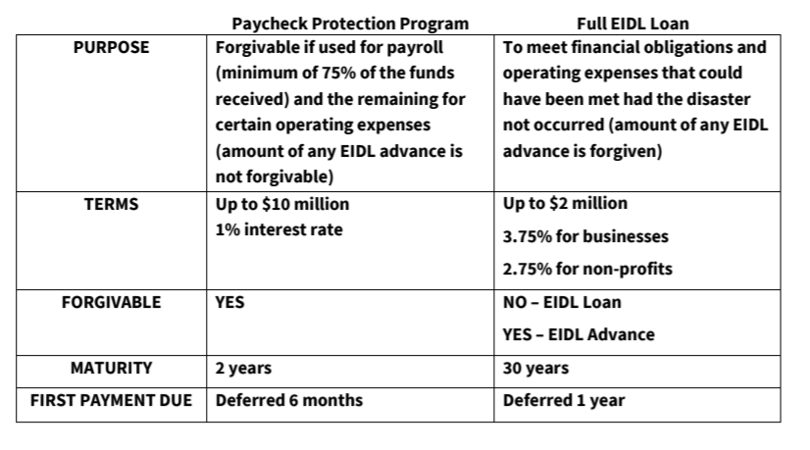
Comparison

Slide 12
sfomail@sba.gov
415-744-3820

